Slide 2
Topics
Procedural and Object-Oriented Programming
Classes
Working with Instances

Slide 3
Reading Assignment
Please read the following sections of the textbook:
  10.1 Procedural and Object-Oriented Programming
  10.2 Classes
  10.3 Working with Instances [Skip Pickling Your Own Objects and Storing Objects in a Dictionary]

Slide 4

Procedural Programming
Procedural programming: writing programs made of functions that perform specific tasks
  Procedures typically operate on data items that are separate from the procedures
  Data items commonly passed from one procedure to another
  Focus: to create procedures that operate on the program’s data

Slide 5
Object-Oriented Programming
Object-oriented programming: focused on creating objects
Object: entity that contains data and procedures
  Data is known as data attributes and procedures are known as methods
    Methods perform operations on the data attributes
Encapsulation: combining data and code into a single object

Slide 6
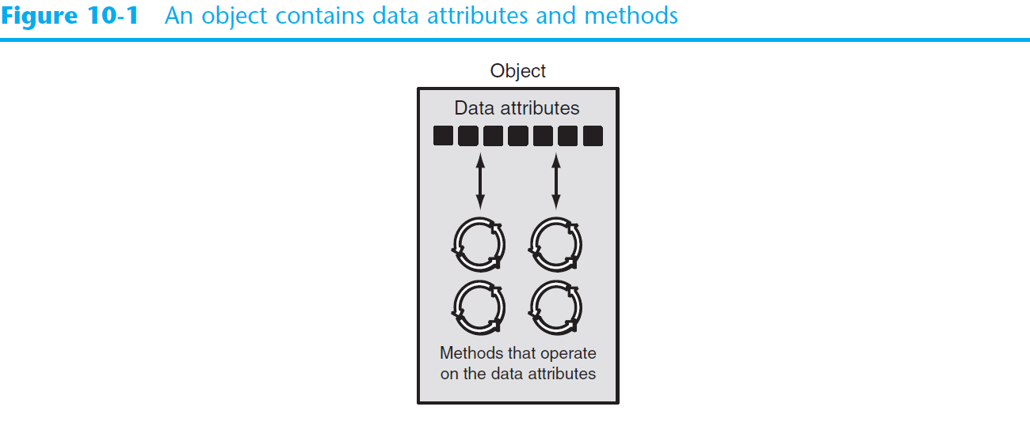
Object-Oriented Programming (cont’d.)

Slide 7
Object-Oriented Programming (cont’d.)
Data hiding: object’s data attributes are hidden from code outside the object
  Access restricted to the object’s methods
    Protects from accidental corruption
    Outside code does not need to know internal structure of the object
Object reusability: the same object can be used in different programs
  Example: 3D image object can be used for architecture and game programming

Slide 8
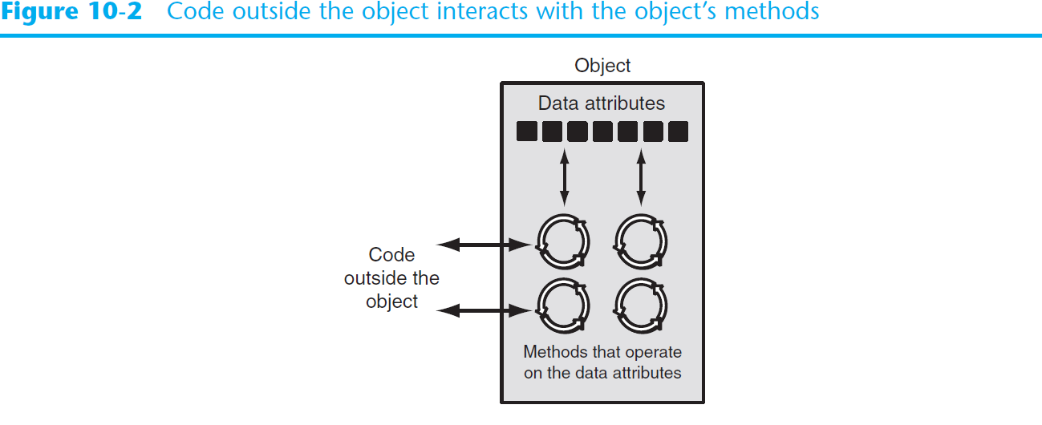
Object-Oriented Programming (cont’d.)

Slide 9
An Everyday Example of an Object
Data attributes: define the state of an object
  Example: clock object would have second, minute, and hour data attributes
Public methods: allow external code to manipulate the object
  Example: set_time, set_alarm_time
Private methods: used for object’s inner workings

Slide 10
Classes
Class: code that specifies the data attributes and methods of a particular type of object
  Similar to a blueprint of a house or a cookie cutter
Instance: an object created from a class
  Similar to a specific house built according to the blueprint or a specific cookie
  There can be many instances of one class

Slide 11
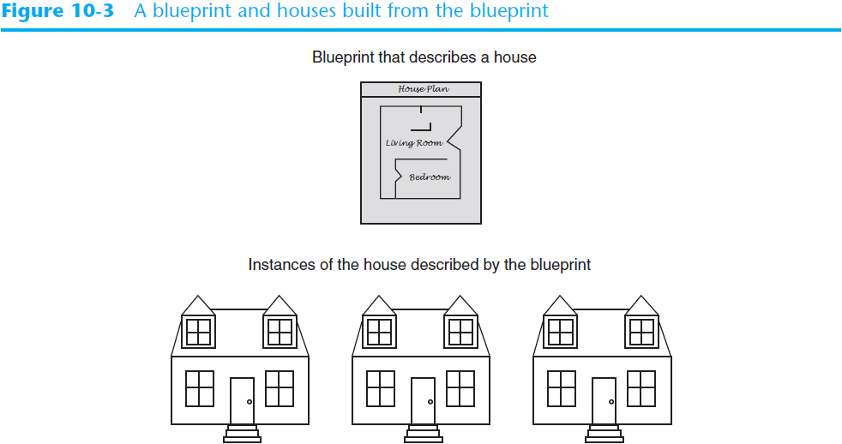
Classes (cont’d.)

Slide 12
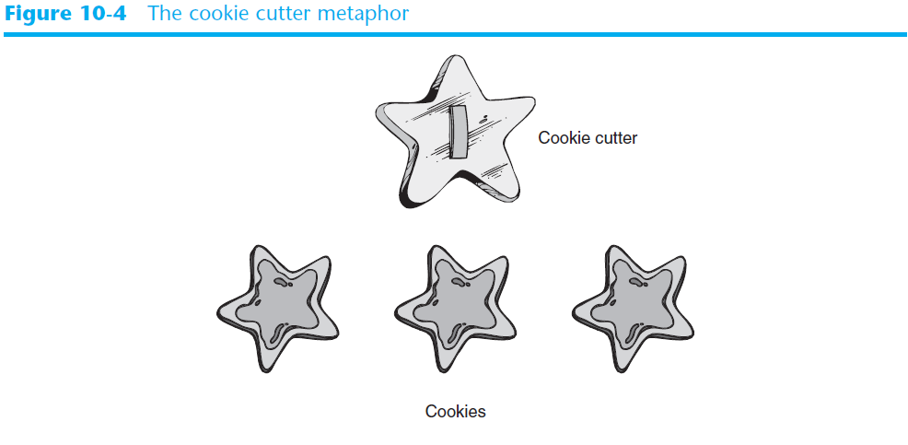
Classes (cont’d.)

Slide 13
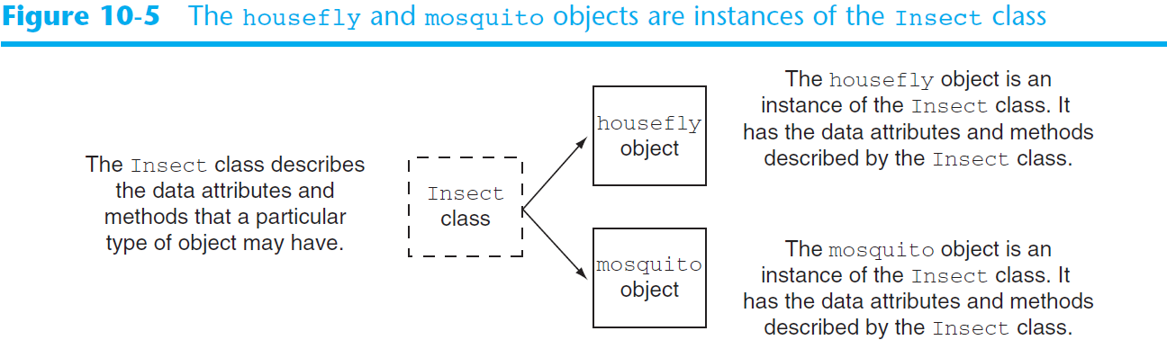
Classes (cont’d.)

Slide 14
Class Definitions
Class definition: set of statements that define a class’s methods and data attributes
  Format: begin with class Class_name:
    Class names often start with uppercase letter
  Method definition like any other python function definition
    self parameter: required in every method in the class – references the specific object that the method is working on

Slide 15
Class Definitions (cont’d.)
Initializer method: automatically executed when an instance of the class is created
  Initializes object’s data attributes and assigns self parameter to the object that was just created
  Format: def __init__ (self):
  Usually the first method in a class definition

Slide 16
Example 1
Write a program to simulate tossing a coin. First define a Coin class, which has methods to toss a coin and to return which side is up.

Slide 17
Example 1 Part 1: Defining Class Coin
import random
class Coin:
def __init__(self):
self.sideup = 'Heads'
# end of def __init__
def toss(self):
if random.randint(0,1) == 0:
self.sideup = 'Heads'
else:
self.sideup = 'Tails'
# end of def toss
def get_sideup(self):
return self.sideup
# end of def get_sideup
# end of class Coin

Slide 18
Class Definitions (cont’d.)
To create a new instance of a class call the initializer method
  Format: My_instance = Class_Name()
To call any of the class methods using the created instance, use dot notation
  Format: My_instance.method()
  Because the self parameter references the specific instance of the object, the method will affect this instance
    Reference to self is passed automatically

Slide 19
Example 1 Part 2: Using Class Coin
def main():
my_coin = Coin()
print('This side is up:', my_coin.get_sideup())
print('I am tossing the coin...')
my_coin.toss()
print('This side is up:', my_coin.get_sideup())
# end of def main
main()

Slide 20
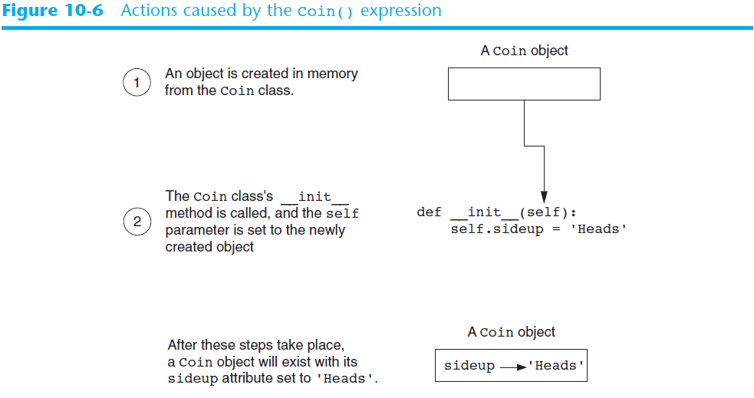
Class Definitions (cont’d.)

Slide 21
Hiding Attributes
An object’s data attributes should be private
  It is a good idea to block access to an object’s data attributes from the outside
  For example, should not allow outside code to pick heads or tails, which is possible in example 1

Slide 22
Example 1A: Cheating
import random
class Coin:
def __init__(self):
self.sideup = 'Heads'
# end of def __init__
def toss(self):
if random.randint(0,1) == 0:
self.sideup = 'Heads'
else:
self.sideup = 'Tails'
# end of def toss
def get_sideup(self):
return self.sideup
# end of def get_sideup
# end of class Coin
def main():
my_coin = Coin()
print('This side is up:', my_coin.get_sideup())
print('I am tossing the coin...')
my_coin.toss()
my_coin.sideup = 'Heads' #cheating
print('This side is up:', my_coin.get_sideup())
# end of def main
main()

Slide 23
Hiding Attributes
An object’s data attributes should be private
  To make a data attribute private, place two underscores (__) in front of attribute name
    Example: __current_minute

Slide 24
Example 1B: Private Data Attribute
import random
class Coin:
def __init__(self):
self.__sideup = 'Heads'
# end of def __init_
def toss(self):
if random.randint(0,1) == 0:
self.__sideup = 'Heads'
else:
self.__sideup = 'Tails'
# end of def toss
def get_sideup(self):
return self.__sideup
# end of get_sideup
# end of class Coin
def main():
my_coin = Coin()
print('This side is up:', my_coin.get_sideup())
print('I am tossing the coin...')
my_coin.toss()
my_coin.__sideup = 'Heads'
# has no effect because my_coin.__sideup is private
print('This side is up:', my_coin.get_sideup())
# end of class main
main()

Slide 25
Storing Classes in Modules
Programmers commonly organize their class definitions by storing them in modules
  Filename for module must end in .py
  Module can be imported to programs that use the class

Slide 26
Example 1C: coin.py
import random
class Coin:
def __init__(self):
self.__sideup = 'Heads'
def toss(self):
if random.randint(0,1) == 0:
self.__sideup = 'Heads'
else:
self.__sideup = 'Tails'
def get_sideup(self):
return self.__sideup

Slide 27
Example 1c: Lesson14_Example01C.py
import coin
def main():
my_coin = coin.Coin() # module_name.class_name
print('This side is up:', my_coin.get_sideup())
print('I am tossing the coin...')
my_coin.toss()
print('This side is up:', my_coin.get_sideup())
# end of main
main()

Slide 28
The BankAccount Class – More About Classes
Class methods can have multiple parameters in addition to self
  For __init__, parameters needed to create an instance of the class
    Example: a BankAccount object is created with a balance
      When called, the initializer method receives a value to be assigned to a __balance attribute
  For other methods, parameters needed to perform required task
    Example: deposit method amount to be deposited

Slide 29
Example 2: bankaccount.py
class Bankaccount:
def __init__(self, bal):
self.__balance = bal
# end of def __init__
def deposit(self, amount):
self.__balance += amount
# end of def deposit
def withdraw(self, amount):
if self.__balance >= amount:
self.__balance -= amount
else:
print('Error: Insufficient funds')
# end of withdraw
def get_balance(self):
return self.__balance
# end of get_balance
# end of class Bankaccount

Slide 30
Example 2: Lesson14_Example02.py
import bankaccount
def main():
start_bal = float(input('Enter your starting balance: '))
savings = bankaccount.Bankaccount(start_bal)
pay = float(input('How much were you paid this week? '))
print('I will deposit that into your account.')
savings.deposit(pay)
print('Your account balance is $', savings.get_balance())
cash = float(input('How much would you like to withdraw? '))
print('I will withdraw that from your account.')
savings.withdraw(cash)
print('Your account balance is $', savings.get_balance())
# end of def main
main()

Slide 31
Working With Instances
Instance attribute: belongs to a specific instance of a class
  Created when a method uses the self parameter to create an attribute
If many instances of a class are created, each would have its own set of attributes

Slide 32
Example 3: Lesson14_Example03.py
import coin
def main():
coin1 = coin.Coin()
coin2 = coin.Coin()
coin3 = coin.Coin()
print(coin1.get_sideup())
print(coin2.get_sideup())
print(coin3.get_sideup())
print()
print('I am tossing all three coins...')
coin1.toss()
coin2.toss()
coin3.toss()
print(coin1.get_sideup())
print(coin2.get_sideup())
print(coin3.get_sideup())
print()
# end of def main
main()

Slide 33
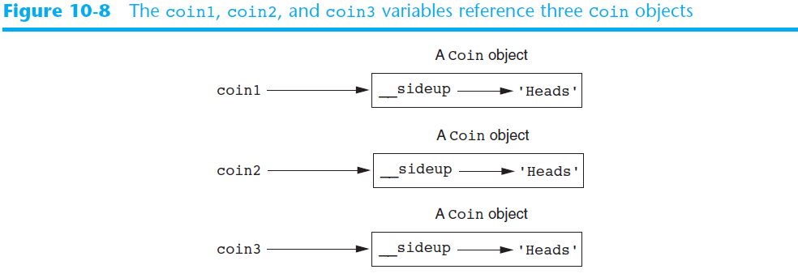
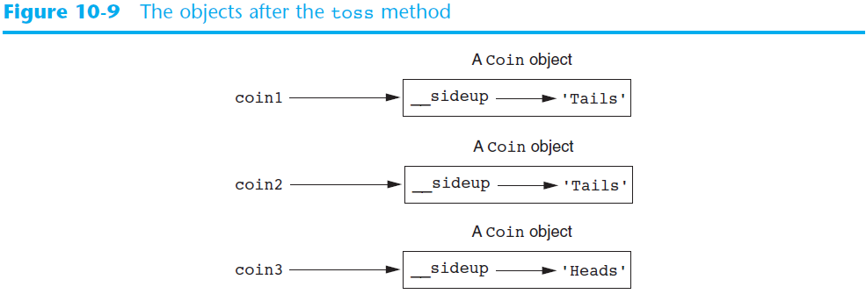

Slide 34
Accessor and Mutator Methods
Typically, all of a class’s data attributes are private and provide methods to access and change them
Accessor methods: return a value from a class’s attribute without changing it
  Safe way for code outside the class to retrieve the value of attributes
Mutator methods: store or change the value of a data attribute

Slide 35
Example 4
Write a program to hold information of a cell phone, including manufacturer, model and retail price. Create and use a class CellPhone.

Slide 36
Example 4 : cellphone.py
class CellPhone:
def __init__(self, manufact, model, price):
self.__manufact = manufact
self.__model = model
self.__retail_price = price
# end of def __init__
def set_manufact(self, manufact):
self.__manufact = manufact
# end of def set_manufact
def set_model(self, model):
self.__model = model
# end of set_model
def set_retail_price(self, price):
self.__retail_price = price
# end of set_retail_orice
def get_manufact(self):
return self.__manufact
# end of def get_manufact
def get_model(self):
return self.__model
# end of def get_model
def get_retail_price(self):
return self.__retail_price
# end of def get_retail_price
# end of class Cellphone

Slide 37
Example 4 : Lesson14_Example04.py
import cellphone
def main():
man = input('Enter the manufacturer: ')
mod = input('Enter the model number: ')
retail = float(input('Enter the retail price: '))
phone = cellphone.CellPhone(man, mod, retail)
print('Here is the data you entered: ')
print('Manufacturer:', phone.get_manufact())
print('Model:', phone.get_model())
print('Retail price:', phone.get_retail_price())
# end of def main
main()

Slide 38
Example 5
Rewrite the program Lesson14_Example04.py. This time get and store a list of 5 phones.

Slide 39
Example 5 : Lesson14_Example05.py
import cellphone
def main():
phones = make_list()
print('Here is the data you entered: ')
display_list(phones)
# end of def main
def make_list():
phone_list = []
print('Enter data for 5 phones.')
for count in range(1, 6):
print('Phone number ' + str(count) + ':')
man = input('Enter the manufacturer: ')
mod = input('Enter the model number: ')
retail = float(input('Enter the retail price: '))
print()
phone = cellphone.CellPhone(man, mod, retail)
phone_list.append(phone)
return phone_list
# end of def make_list
def display_list(phone_list):
for item in phone_list:
print(item.get_manufact())
print(item.get_model())
print(item.get_retail_price())
print()
# end of def display_list
main()

Slide 40
Passing Objects as Arguments
Methods and functions often need to accept objects as arguments
When you pass an object as an argument, you are actually passing a reference to the object
  The receiving method or function has access to the actual object
    Methods of the object can be called within the receiving function or method, and data attributes may be changed using mutator methods

Slide 41
Example 6 : Lesson14_Example06.py
import coin
def main():
my_coin = coin.Coin()
print(my_coin.get_sideup())
flip(my_coin)
print(my_coin.get_sideup())
# end of def main
def flip(coin_obj):
coin_obj.toss()
# end of def flip
main()

Slide 42
Summary
This chapter covered:
  Procedural vs. object-oriented programming
  Classes and instances
  Class definitions, including:
    The self parameter
    Data attributes and methods
    __init__ and __str__ functions
    Hiding attributes from code outside a class
  Storing classes in modules

